Slide 1

CODE REFACTORING AND BUG FIXING

Slide 2
About me
I am Manda Divija and I completed my bachelors in computer science and engineering from SRKR engineering college , Bhimavaram with a CGPA of 8.96. I have done an apprenticeship in Data analysis from MedTourEasy. I have done Google professional certification in Data analytics from coursera in order to gain knowledge about Data analytics.
I am an aspiring data analyst with a passion to solve the data related business problems and derive meaningful insights from the data. I consider myself as an active and agile learner with good communication and leadership skills. My technical skills include python, SQL, HTML, CSS, machine learning, Data analysis and C++.

Slide 3
PROBLEM DESCRIPTION
The aim of this project is to Refactor the existing codebase and ensure the proper functioning of the Note Taking application. All the bugs present in the existing code base are to be identified and the issues are to be fixed properly so that the application allows the users to add their notes and all the pre-existing notes should be present in the same page in the form of an unordered list.
The tech-stack used for this application is:
Flask
HTML
CSS

Slide 4
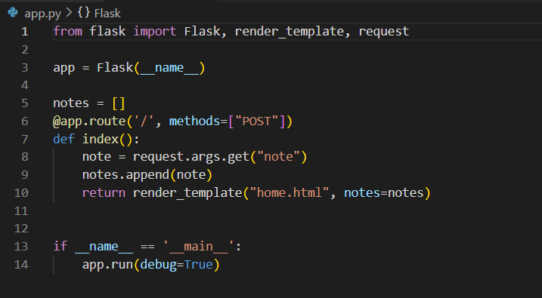
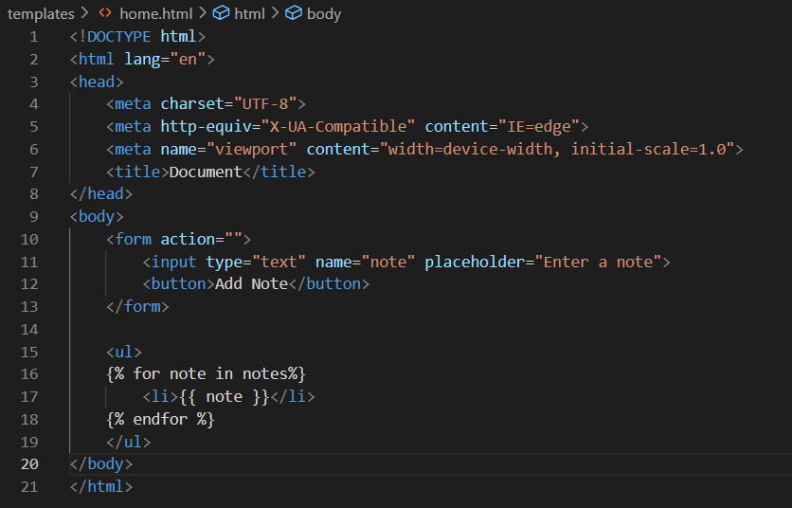
EXISTING CODEBASE
Flask code
HTML code

Slide 5
BUGS IDENTIFIED
BUG-1:
The form tag doesn’t contain the “method” attribute and the “action” attribute is also absent which leads to “Method not allowed” error when the application is in use.

Slide 6
BUGS IDENTIFIED
BUG-2:
The app routing part only accepts the POST requests which results in “Method not allowed” error when the application is used.
BUG-3:
The binding function of the route ‘/’ uses request.args.get() method which accepts the url parameters not the form parameters.

Slide 7
BUG FIXING
BUG-1 can be fixed by using the ‘/’ route in action attribute and ‘post’ value in method attribute in the form tag.
BUG-2 is fixed by using both the ‘POST’ and ‘GET’ methods while using the route.
BUG-3 is solved by using the request.form.get() method in the binding function.
CODE REFACTORING
Code refactoring is the process of restructuring the code without change in it’s functionality.
In order to restructure the additional features are implemented to the HTML template using CSS so the application would be more user friendly.

Slide 8
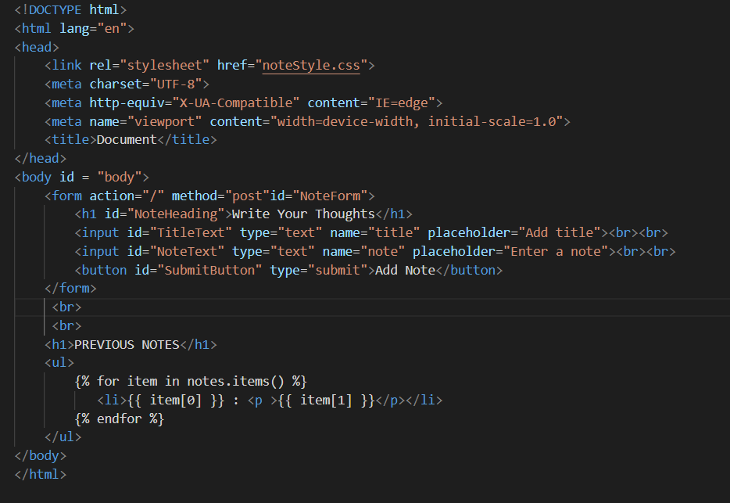
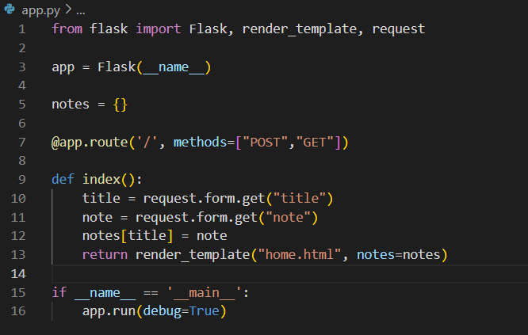
CODE AFTER BUG FIXING
Flask code
HTML code

Slide 9
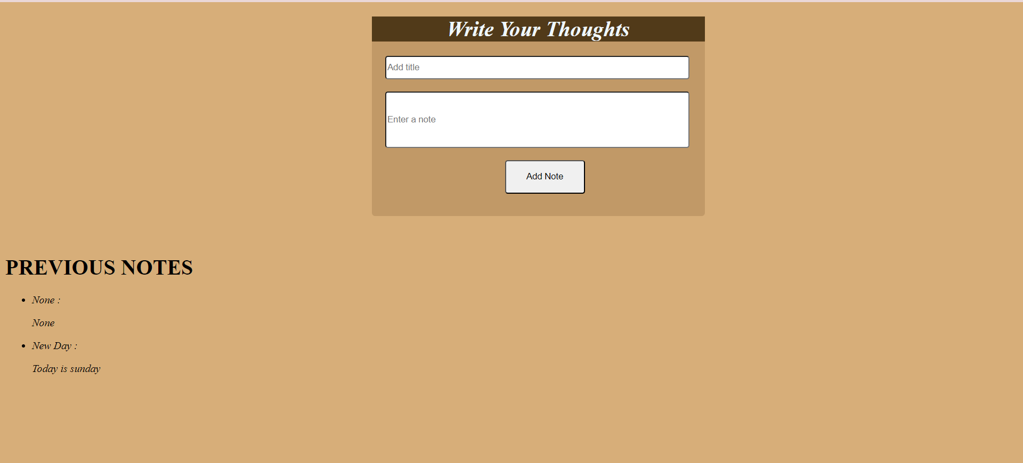
VALIDATION

Slide 10
CONCLUSION
In conclusion , three bugs are identified in the given codebase and they are resolved without changing the functionality of the application. The application allows users to add their notes with an appropriate tile and also review their previous notes. Using Flask framework the application can be further improved by adding the functionalities like allowing users to delete and update their notes.

Slide 11
Q & A

Slide 12

THANK YOU

